Slide 1


St Andrews Bayesian Geochronology
Session 1
Radiocarbon dating and calibration

Slide 2
Schedule
Radiocarbon theory
Age-depth model theory
Age-depth practical (incl. your cores)
13:00 – 17:00

Slide 3
Schedule
Mixing Powerpoint slides with R code
Keep R open, try to run the blue R code on your own computer
Speak up when things go wrong!

Slide 4
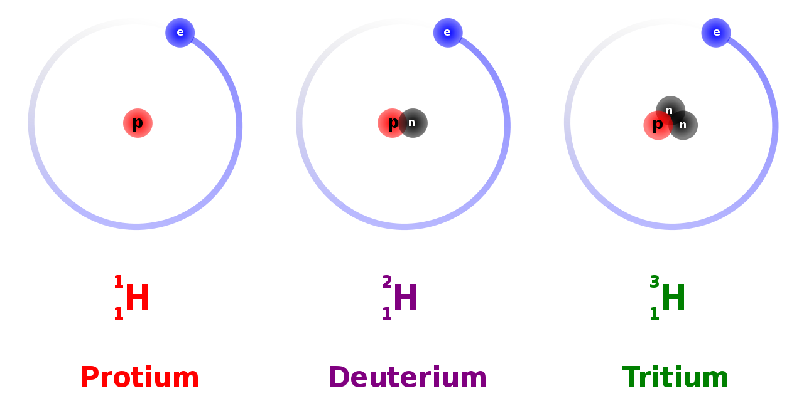
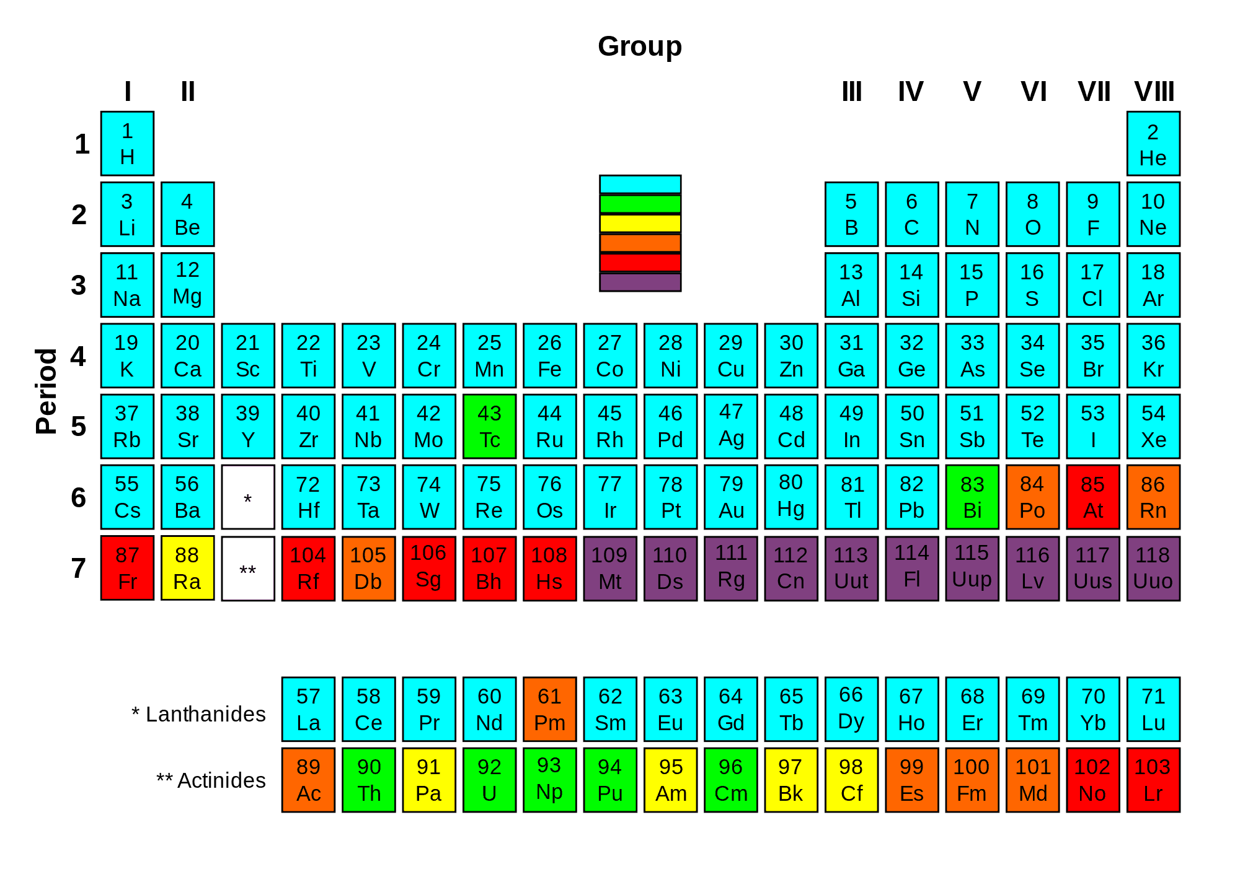
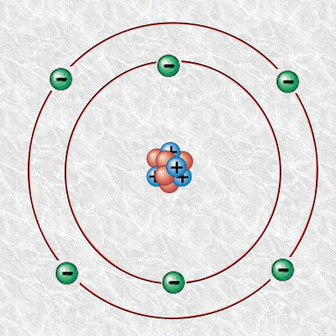
https://www.nuclear-power.com/nuclear-power/reactor-physics/atomic-nuclear-physics/nuclear-stability/

Slide 5
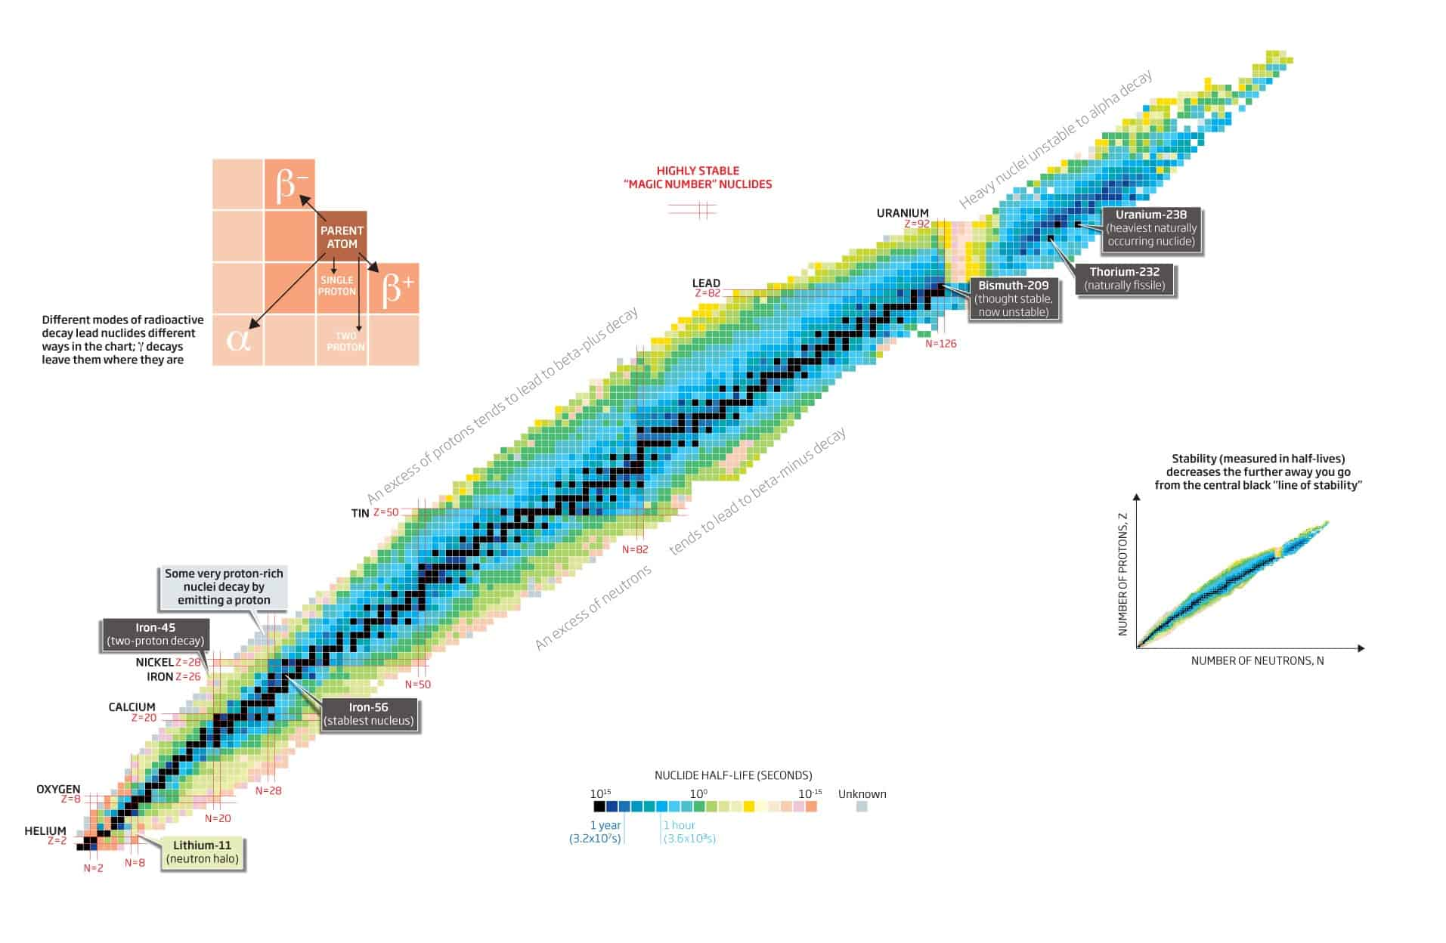
https://www.nuclear-power.com/nuclear-power/reactor-physics/atomic-nuclear-physics/nuclear-stability/

Slide 6
Radioactive decay
Decay rates are constant as far as we know
Not influenced by environment
Average lifespan ¹⁴C 8600 years – half-life 5730
100% at t=0 (AD 1950)

Slide 7
Radioactive decay
List ten half-lives:
yr <- seq(0, by=5730, length=10)
halflives <- 0.5 ^ (0:9)
cbind(yr, 100*halflives)
F¹⁴C = 0.5^{(C14 age/5730)}

Slide 8
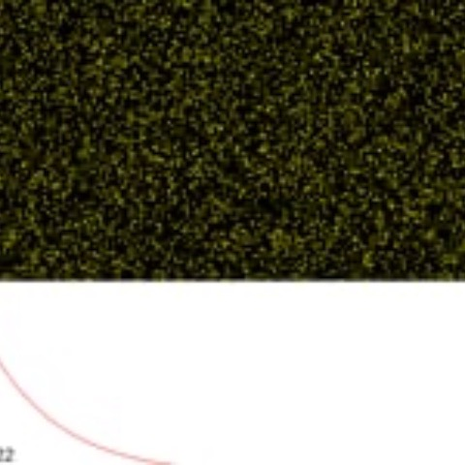
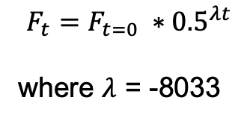
$$F_{t}=F_{t=0} {∗0.5}^{λt}$$
where $λ$ = -8033
https://maarten14c.github.io/

Slide 9
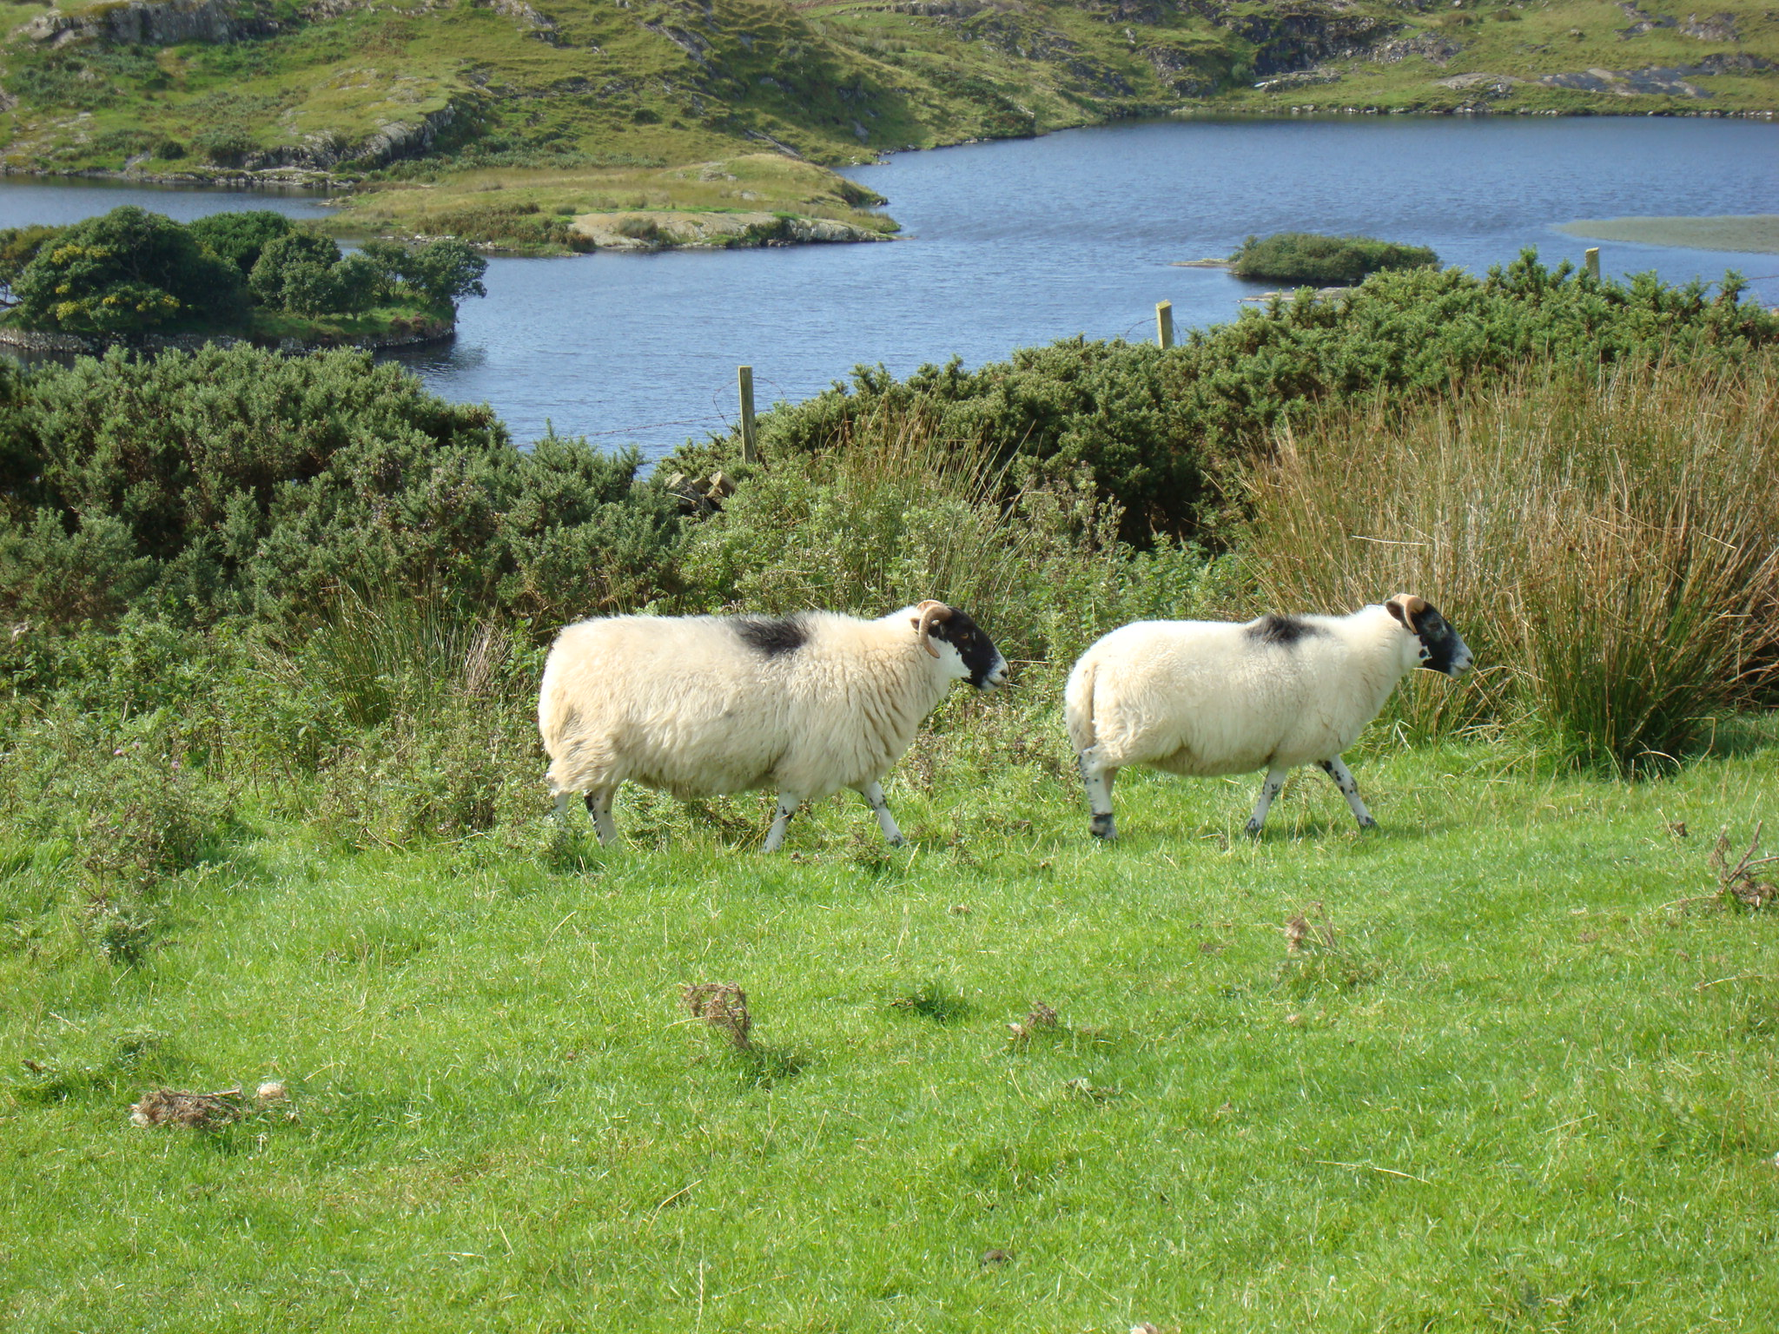
Cosmic rays
¹⁴N + n
¹⁴C + O₂
¹⁴C + p
¹²CO₂
¹⁴CO₂
¹³CO₂
¹⁴C/¹²C
Notes:
14C production
Exchange with reservoirs

Slide 10
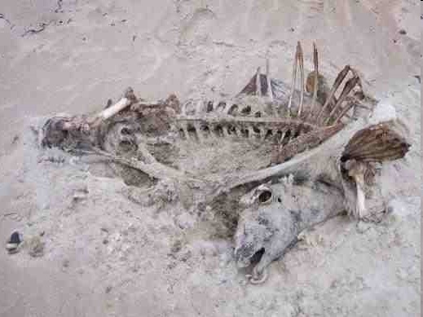
Cosmic rays
¹⁴N + n
¹⁴C + O₂
¹⁴C + p
¹²CO₂
¹⁴CO₂
¹³CO₂
¹⁴C/¹²C
Notes:
14C production
Exchange with reservoirs

Slide 11
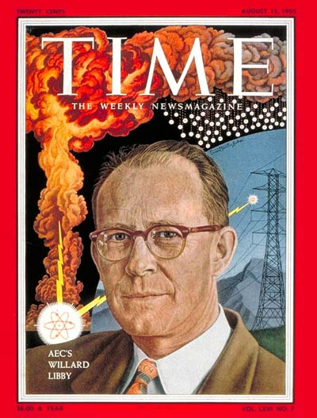
Libby’s ¹⁴C decay counter

Slide 12
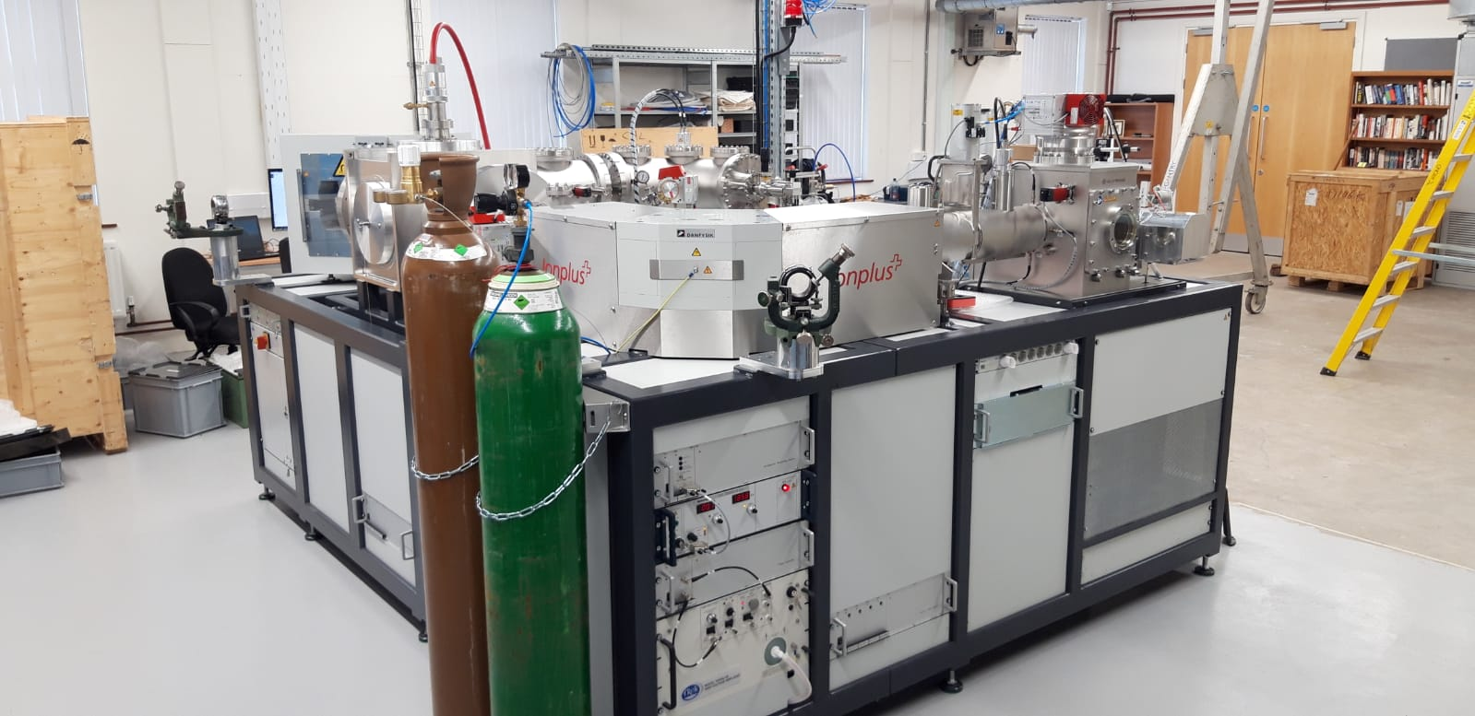
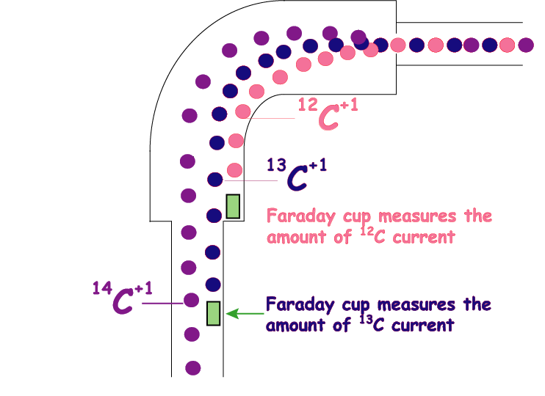

Slide 13
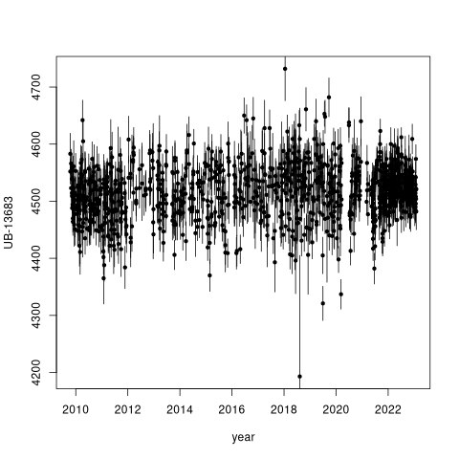
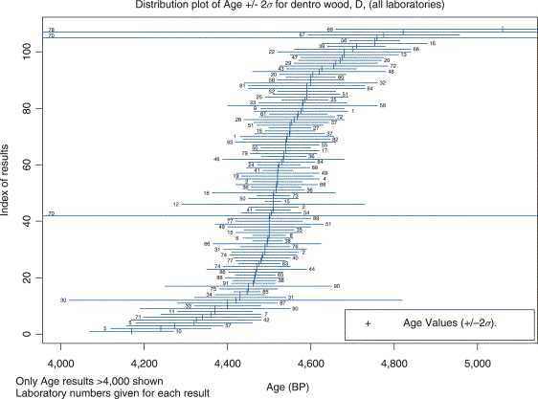
Scott, 2013 (Encycl. Quat. Sci.)
Notes:
13

Slide 14
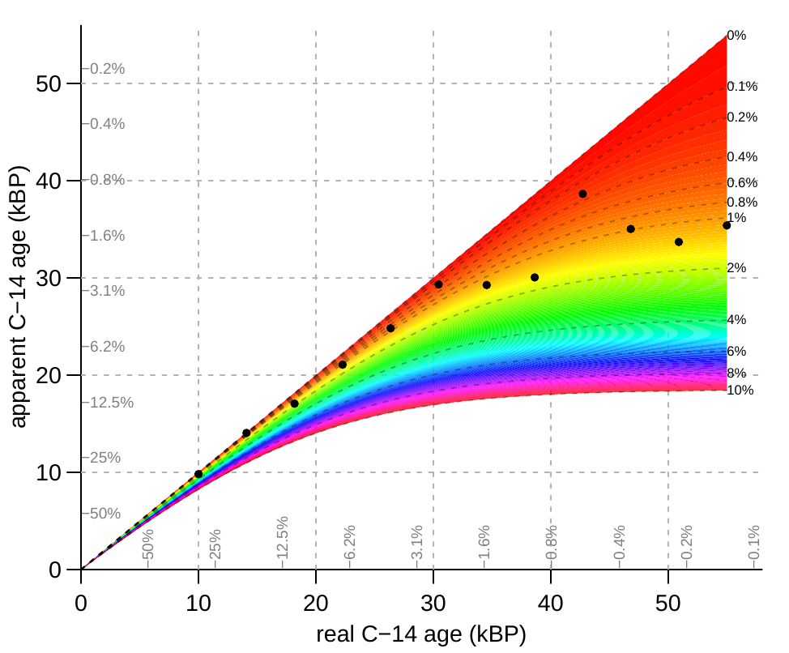
F = 0.5^(¹⁴C age/5573)
F_{obs} = c*F_{c} + (1-c)*F_{real}
F_{c}=1 recent contamination
draw.contamination()
https://cloud.r-project.org/web/packages/rintcal/vignettes/calculations.html

Slide 15
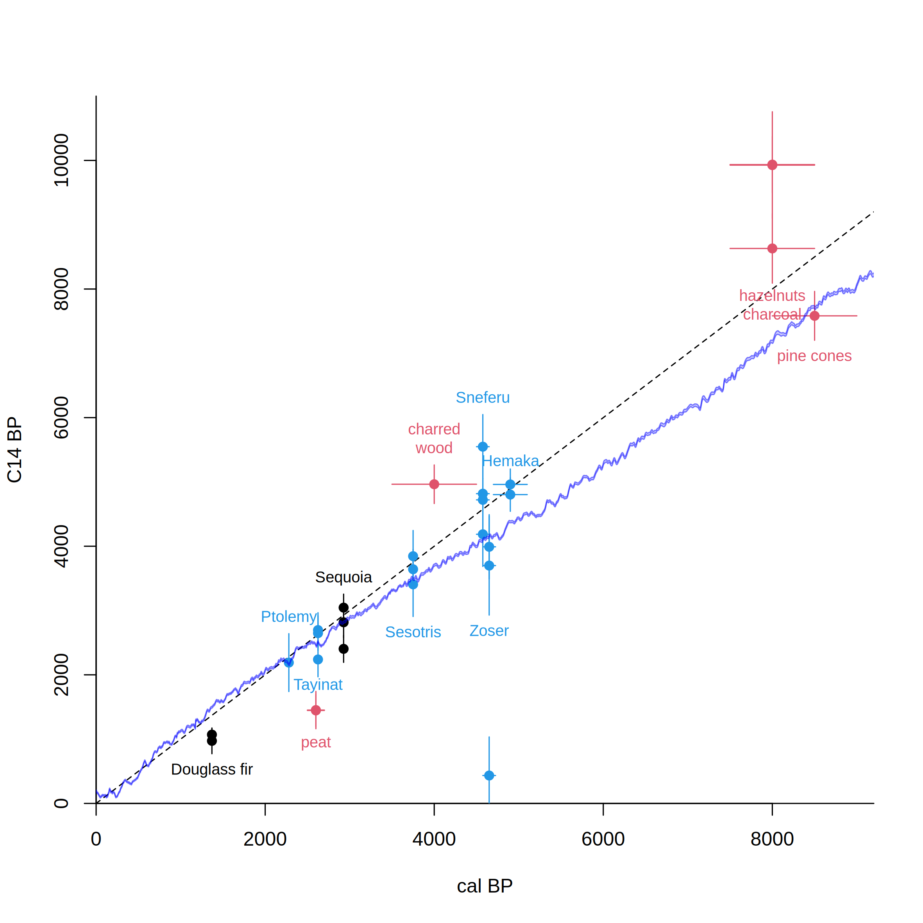
Libby’s Curve of Knowns vs IntCal20
After Arnold & Libby 1951
Science 113, 111-150
Notes:
15

Slide 16
Radiocarbon calibration
CALIBRATION: verification that the method is accurate
Chunks of wood representing 10-20 years were taken from tree-ring dated US trees, and the ¹⁴C in them was measured
The exact age of each tree ring was known
This gave a continuous record of atmospheric ¹⁴C
Confirmed in European labs

Slide 17
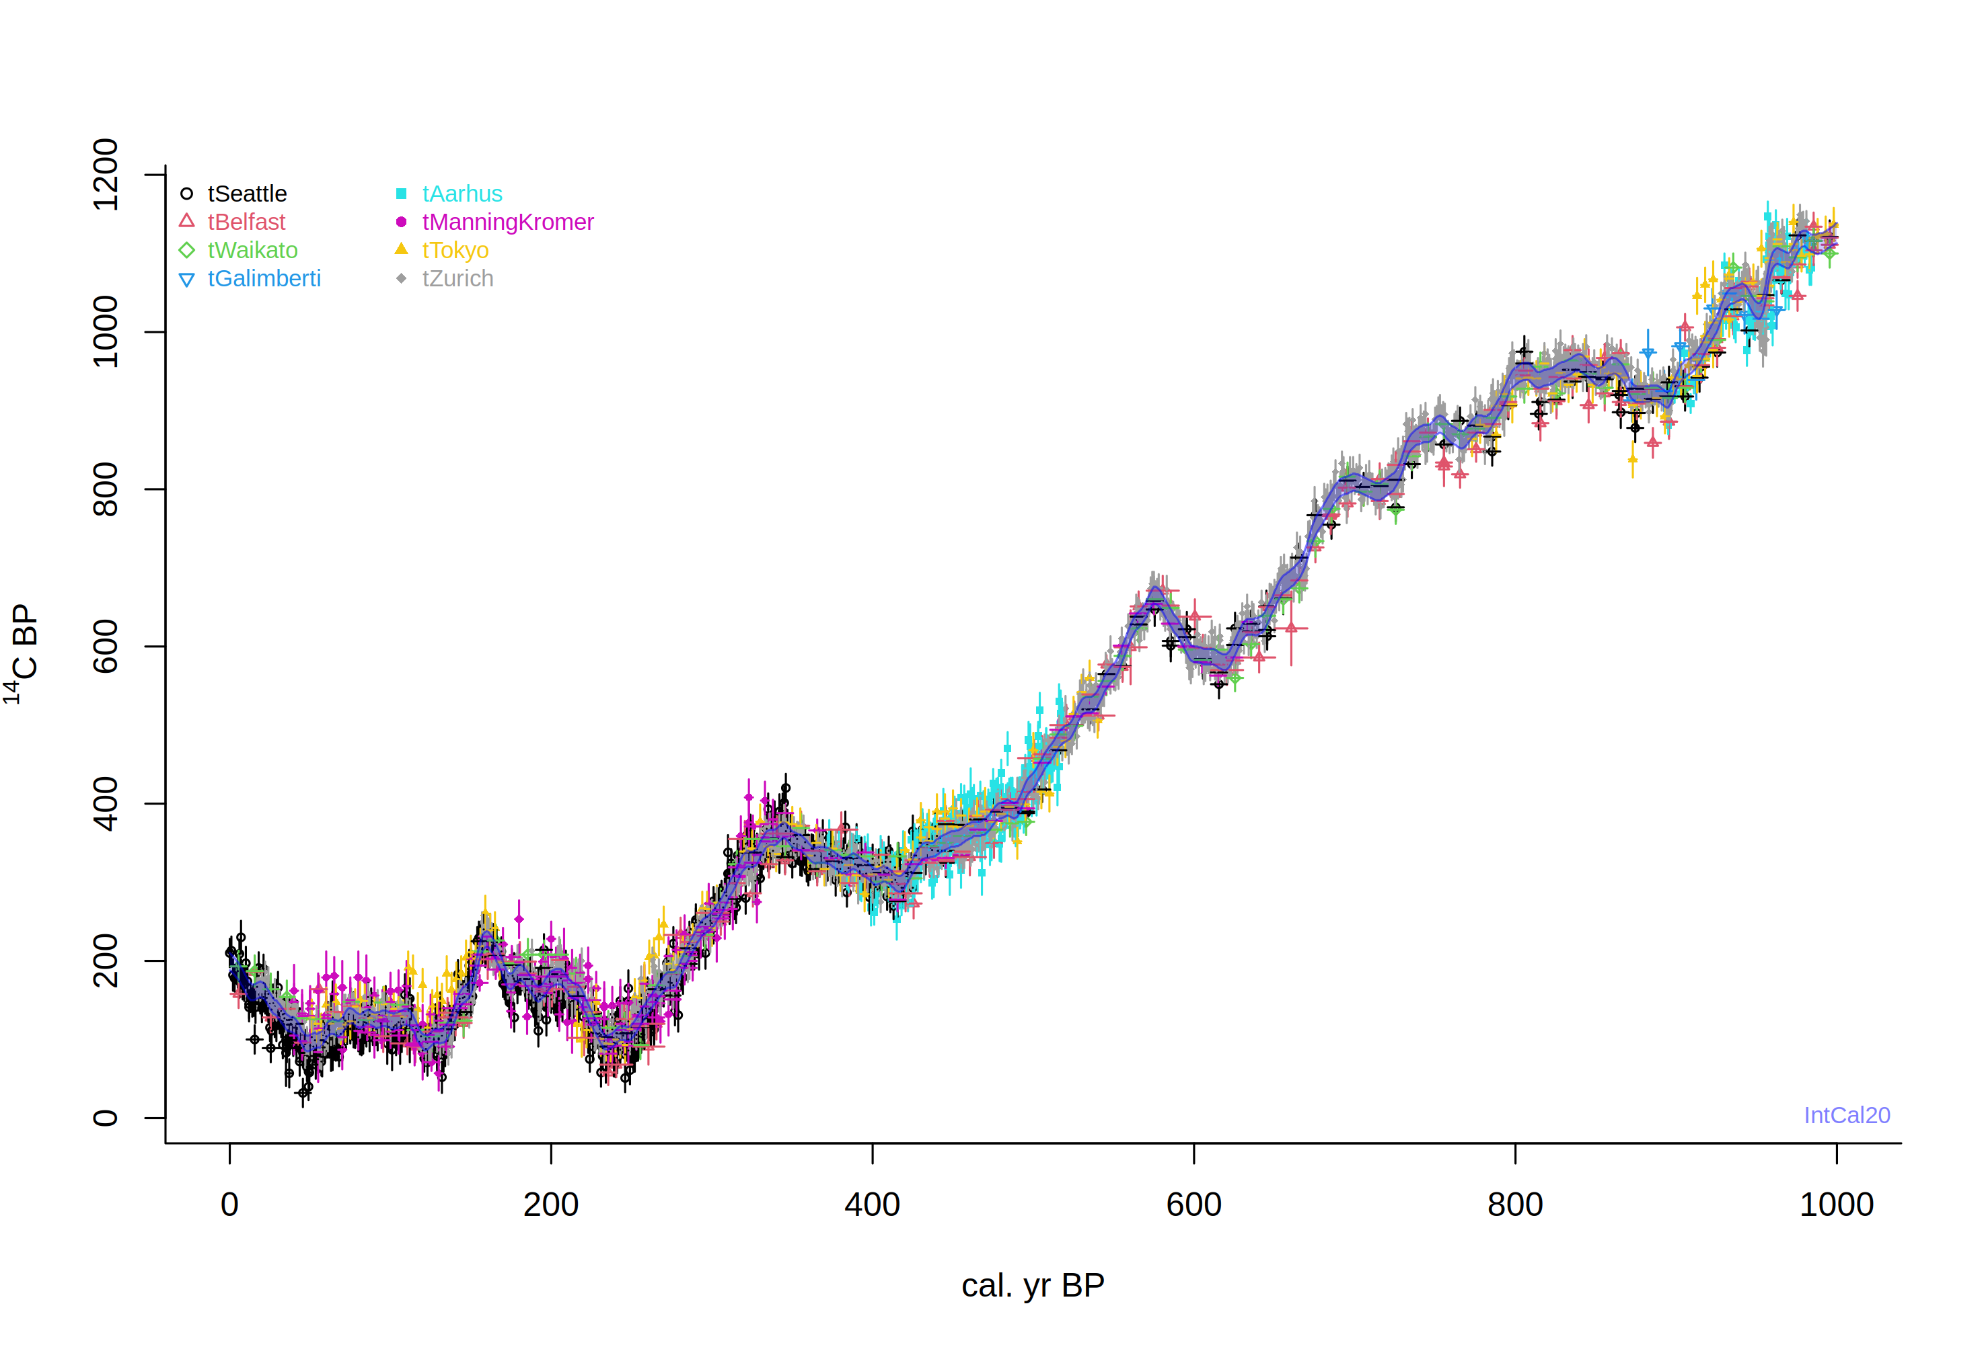
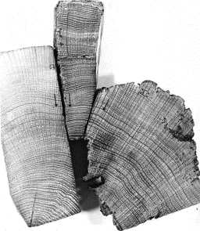
install.packages(‘rintcal’)
require(rintcal)
intcal.data(0, 1000)

Slide 18
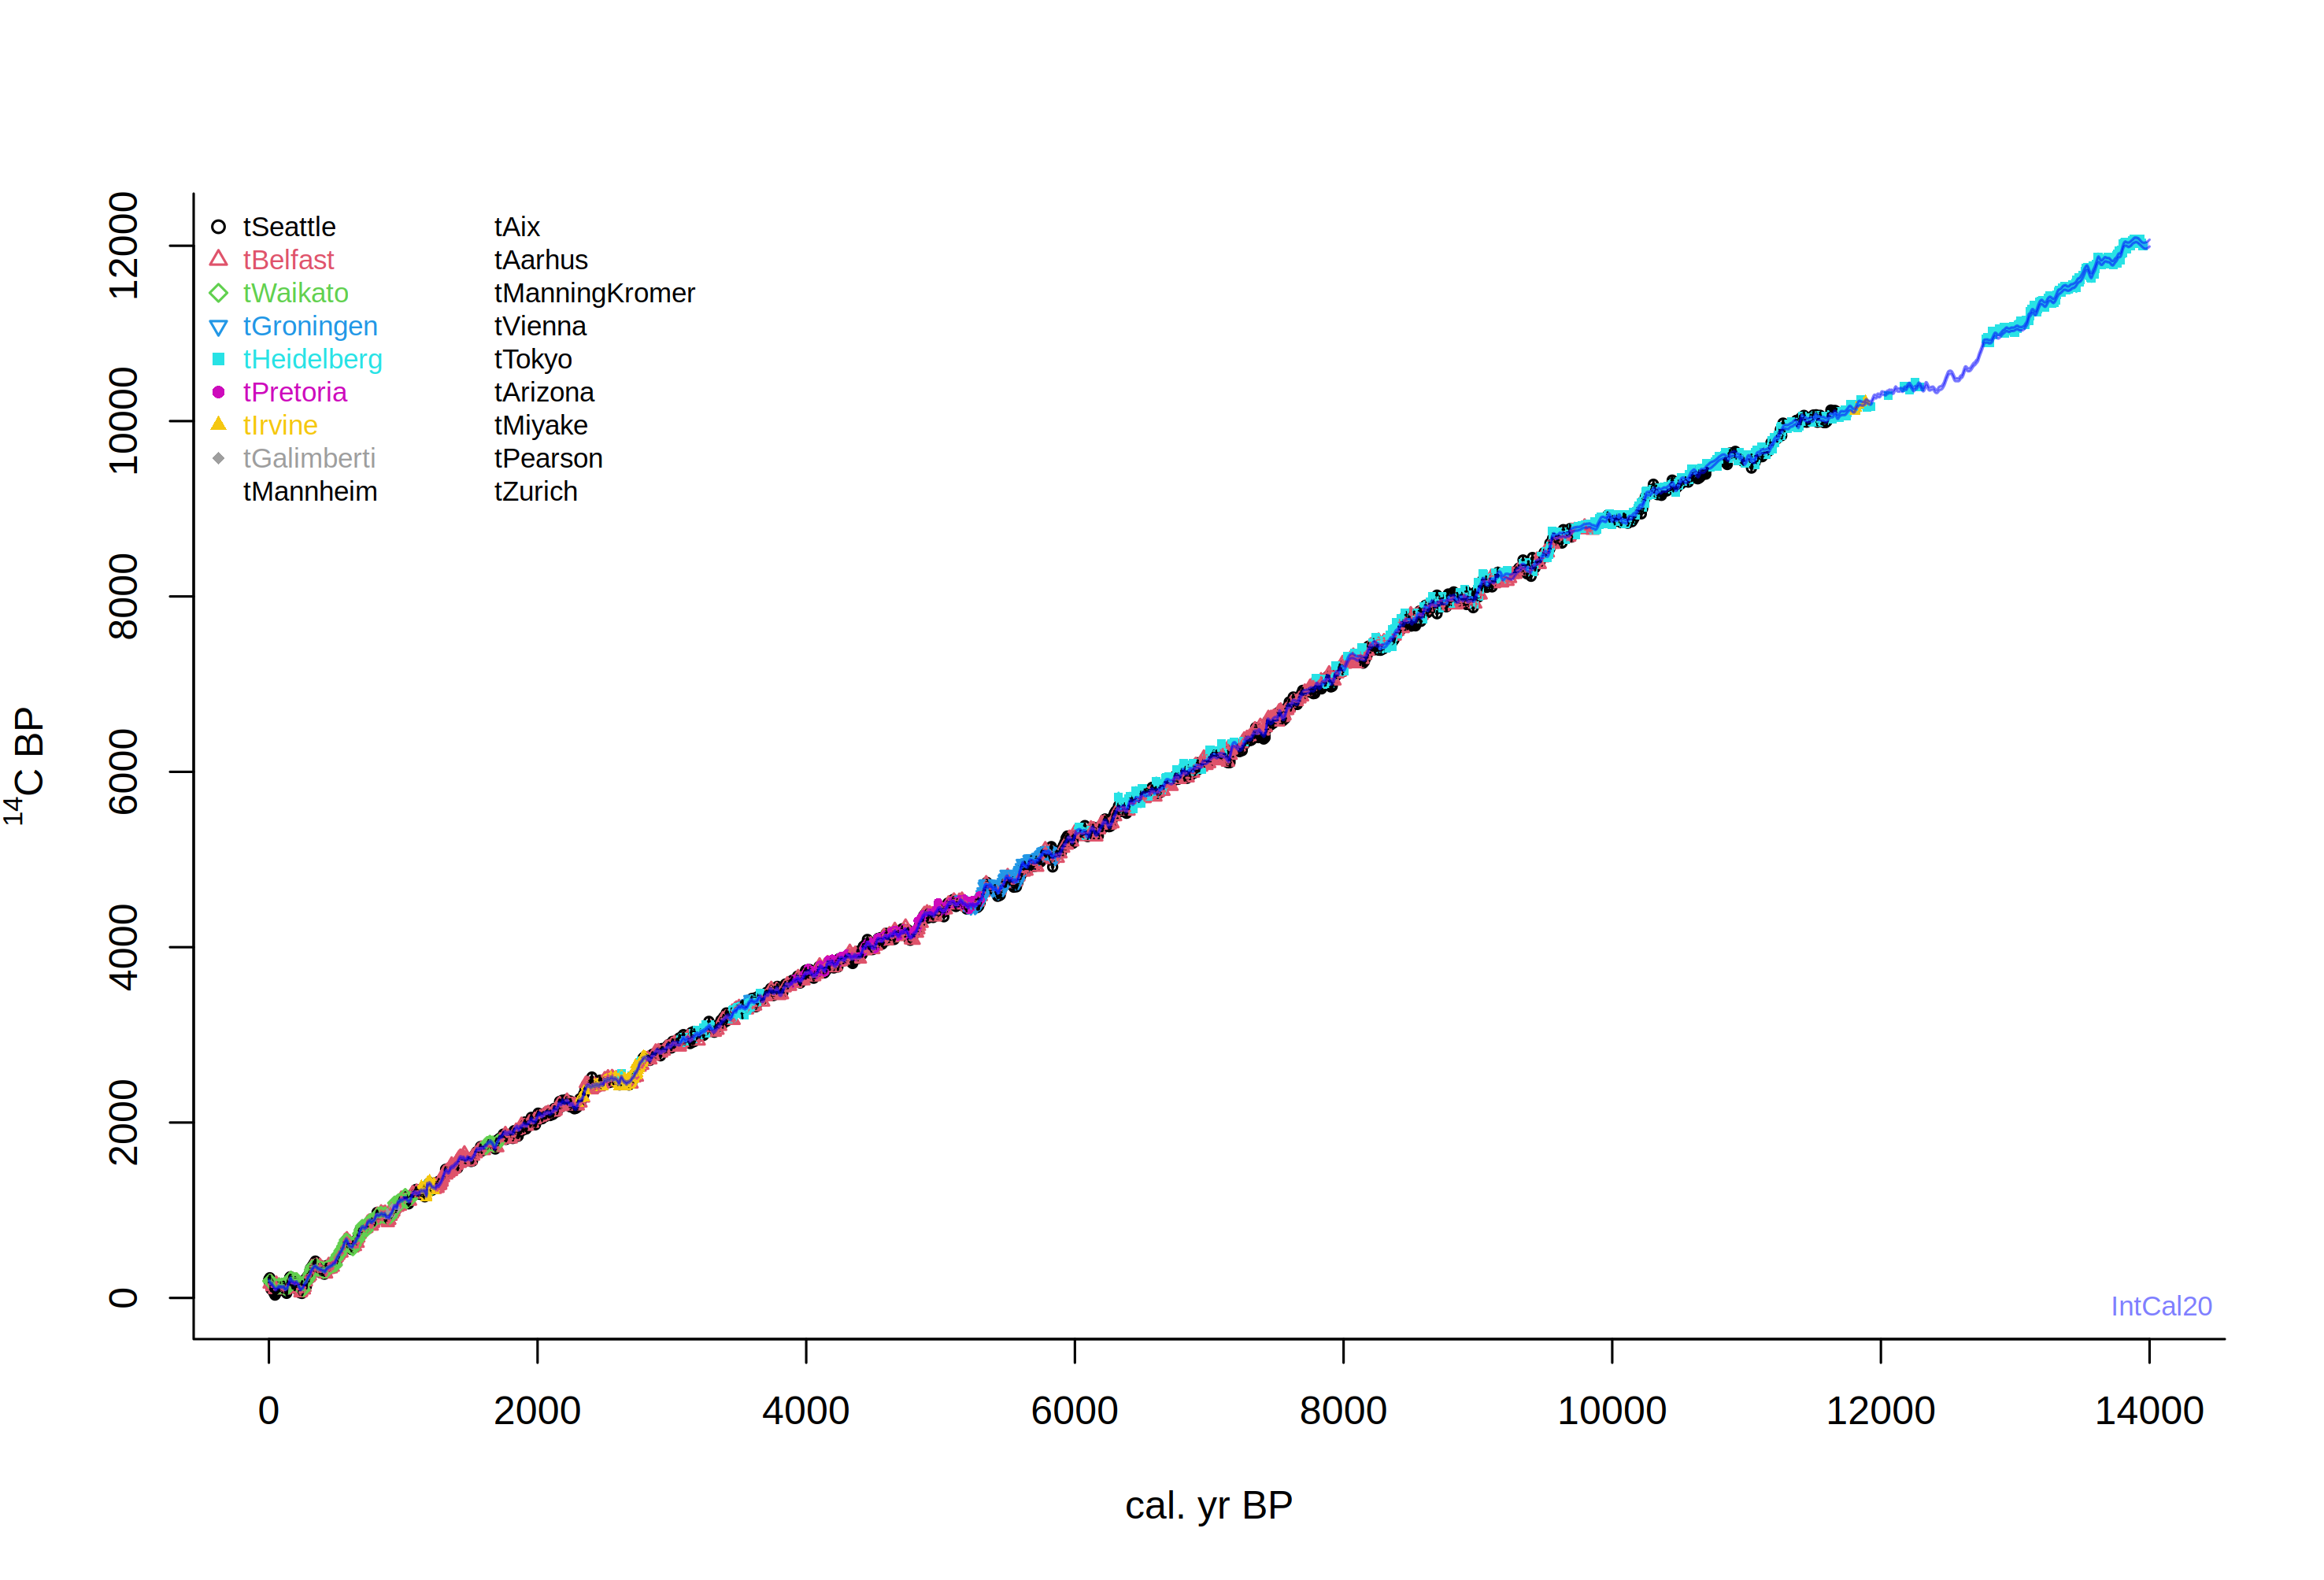

Slide 19
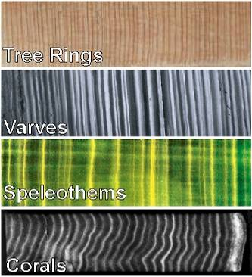
Extension of the ¹⁴C calibration curve
More tree rings (floating)
Varves (marine or lacustrine)
Speleothems
Corals

Slide 20
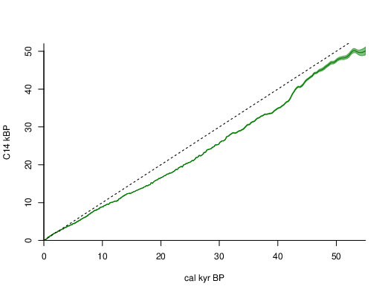
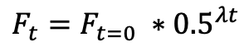
IntCal20
draw.ccurve(ka=TRUE)
$$F_{t}=F_{t=0} {∗0.5}^{λt}$$
Reimer et al. 2020

Slide 21
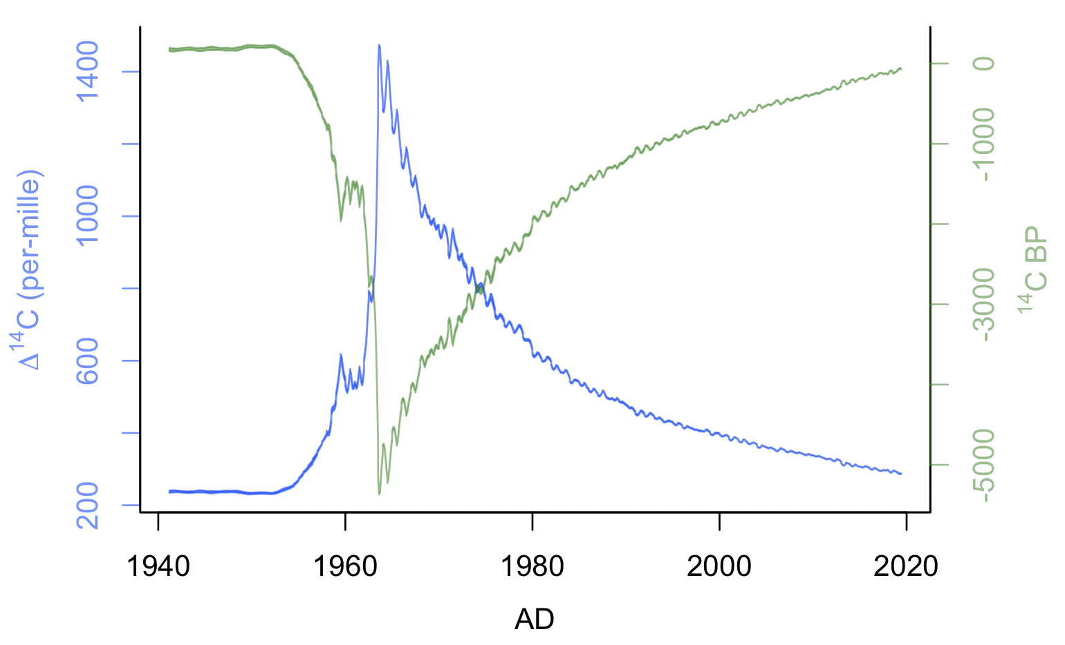
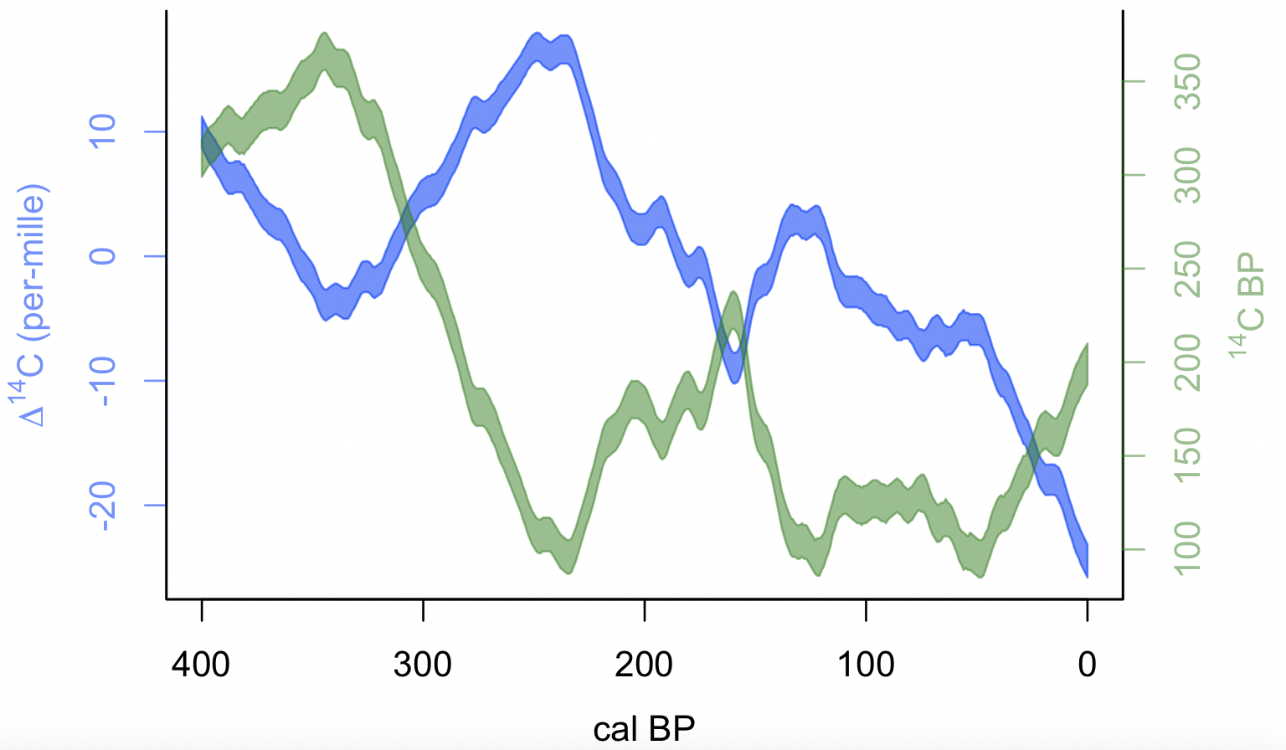
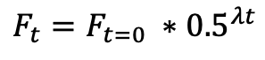
Recent changes of ¹⁴C in the atmosphere
$$F_{t}=F_{t=0} {∗0.5}^{λt}$$
anthropogenic activity (burning of fossil fuels, bomb tests): release of ‘old’ or ‘new’ carbon
draw.D14C(cc=ccurve("NH1_monthly"), BCAD=TRUE, cal.lab="AD")
draw.D14C(400, 0, cal.rev=TRUE)
Notes:
21
de Vries found that 17-th century wood had a 2% higher activity than 19th century wood.

Slide 22
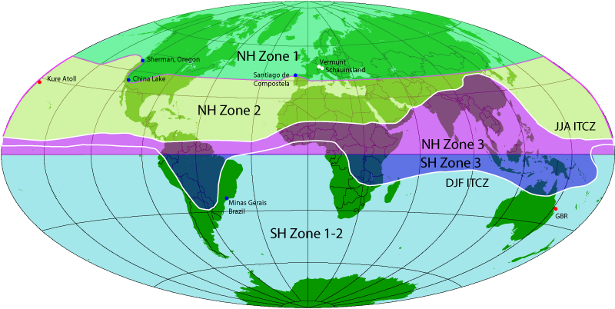
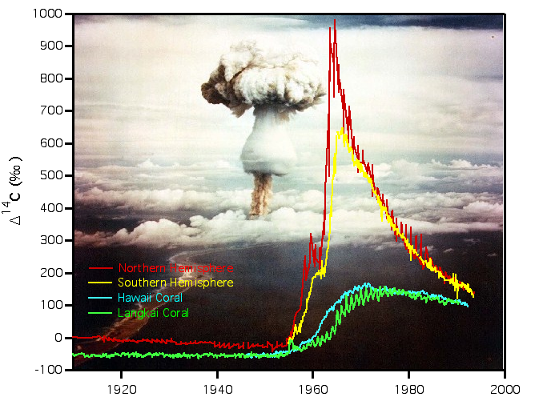
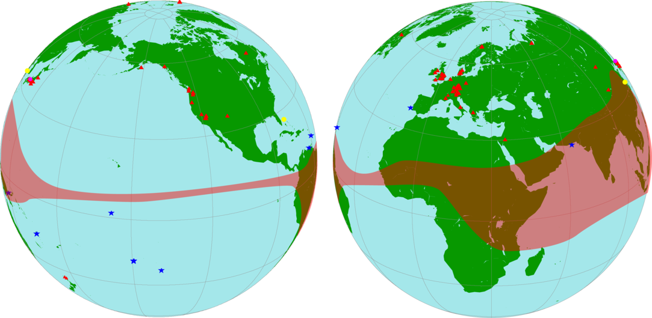
http://calib.org/CALIBomb/
Courtesy Stewart Fallon, LLNL
Reimer et al. 2020 Radiocarbon
Notes:
22

Slide 23
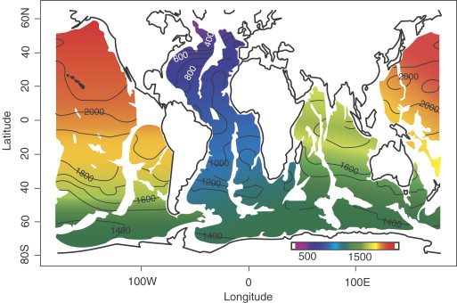
Hughen 2007, Developments in Marine Geology

Slide 24
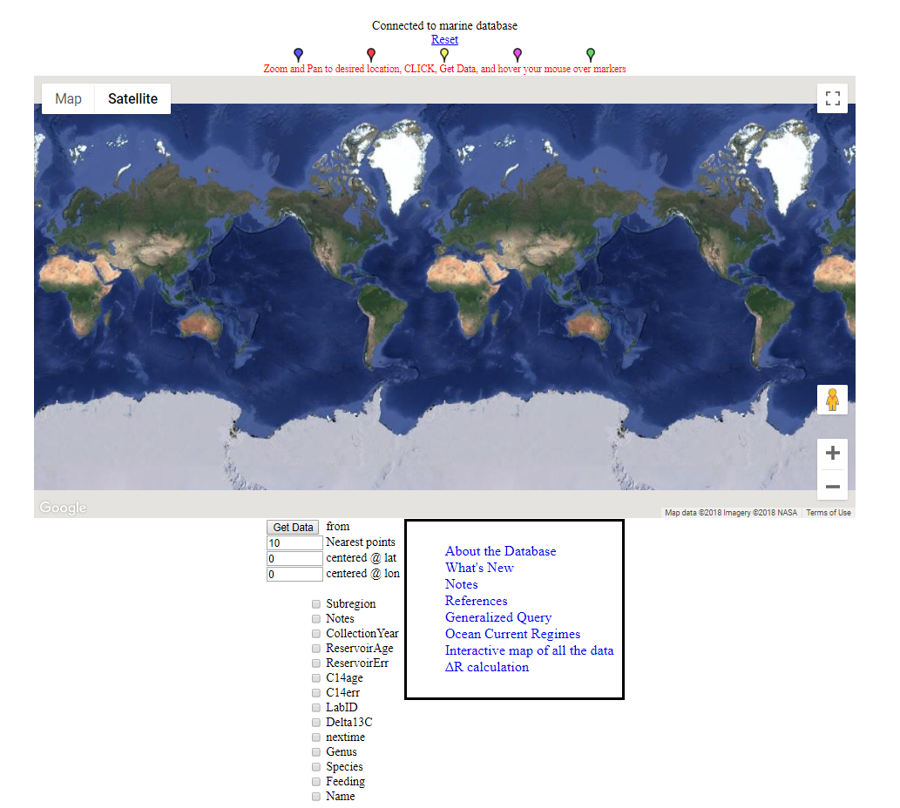
Marine Reservoir Correction Database
http://calib.org/marine/

Slide 25
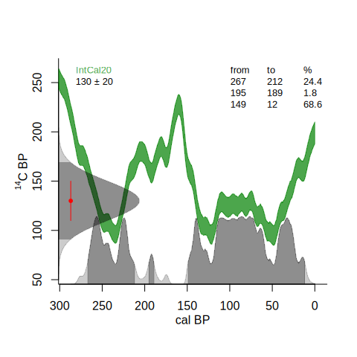
¹⁴C calibration
calibrate()
Notes:
25

Slide 26
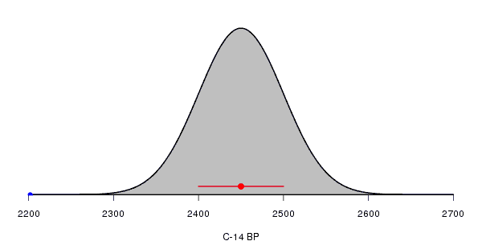
¹⁴C calibration
Each radiocarbon date comes with a lab error
Assumed to be distributed normally/Gaussian
Or alternatively, a student-t distribution with longer tails
Notes:
26

Slide 27
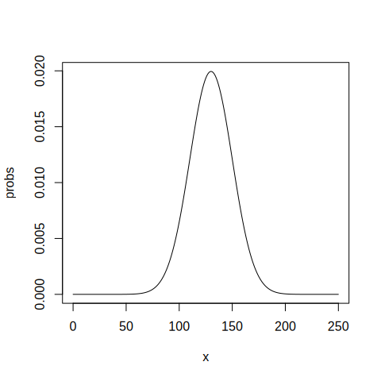
¹⁴C calibration
dnorm(125, 130, 20)
dnorm(130, 130, 20)
x <- 0:250
probs <- dnorm(x, 130, 20)
head(cbind(x, probs))
sum(probs)
plot(x, probs, type="l")
Notes:
27

Slide 29
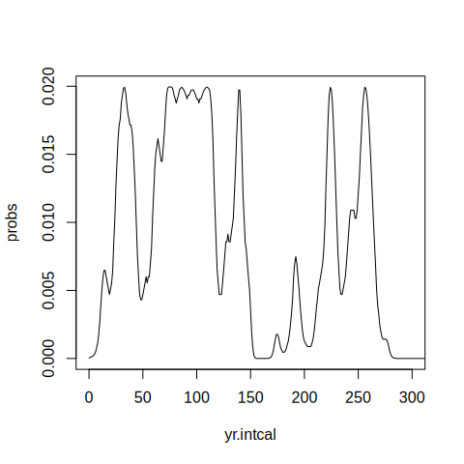
¹⁴C calibration
cc <- ccurve()
head(cc)
yr.intcal <- cc[,1]
c14.intcal <- cc[,2]
probs <- dnorm(c14.intcal, 130, 20)
plot(yr.intcal, probs, xlim=c(0, 300), type="l")
Notes:
29

Slide 30
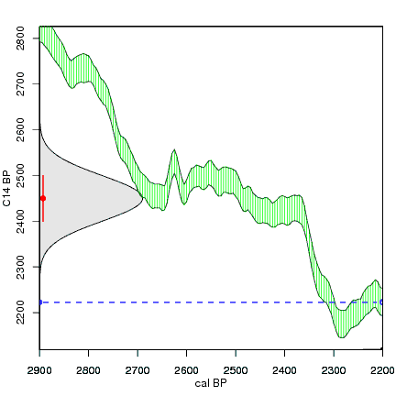
¹⁴C calibration
calibrate()
maarten14c.github.io
Notes:
30

Slide 31
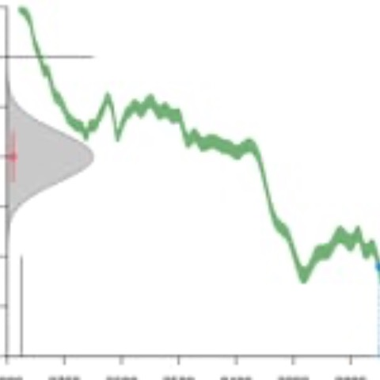
https://vimeo.com/603317968

Slide 32
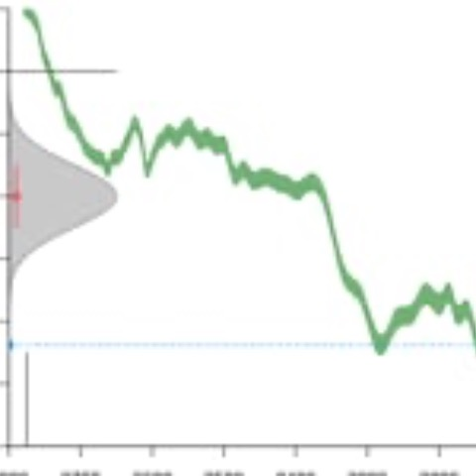
https://vimeo.com/603364618

Slide 33
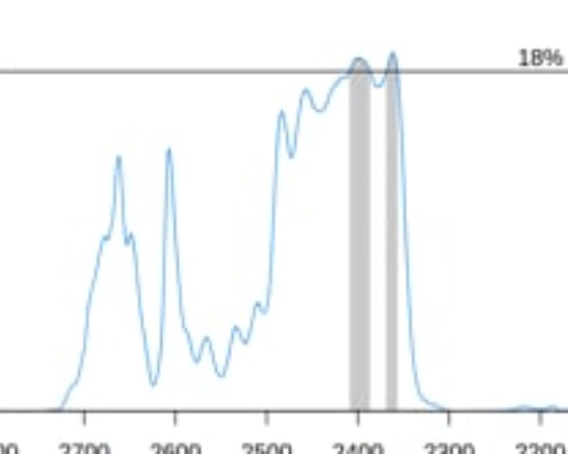
¹⁴C calibration – hpd ranges
https://vimeo.com/603420882
Notes:
33

Slide 34
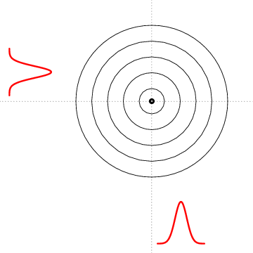
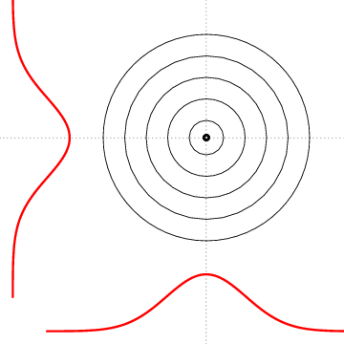
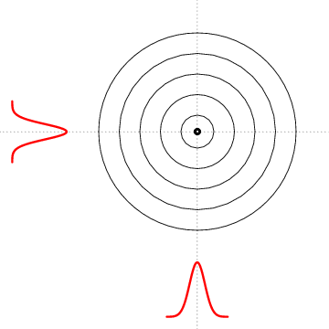
Notes:
34

Slide 35
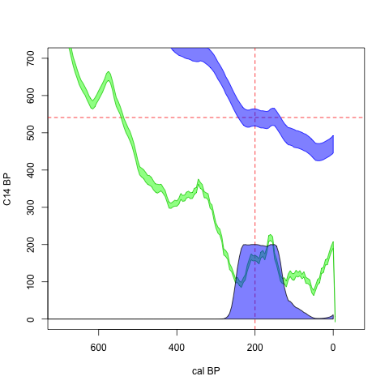
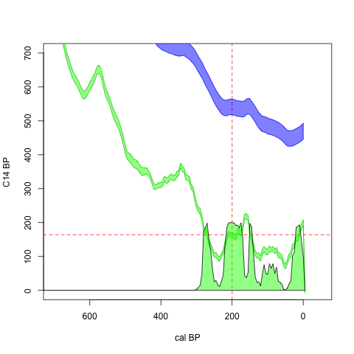

Slide 37
